Slide 1

Birla Institute of Technology and Science, Pilani
CUSTOMER VALUE MODELING (CVM)ENABLING THE SCIENTIFIC ENTERPRISE
Submitted By: Manam Bharadwaj
2021MT13176
2021mt13176@wilp.bits-pilani.ac.in

Slide 2
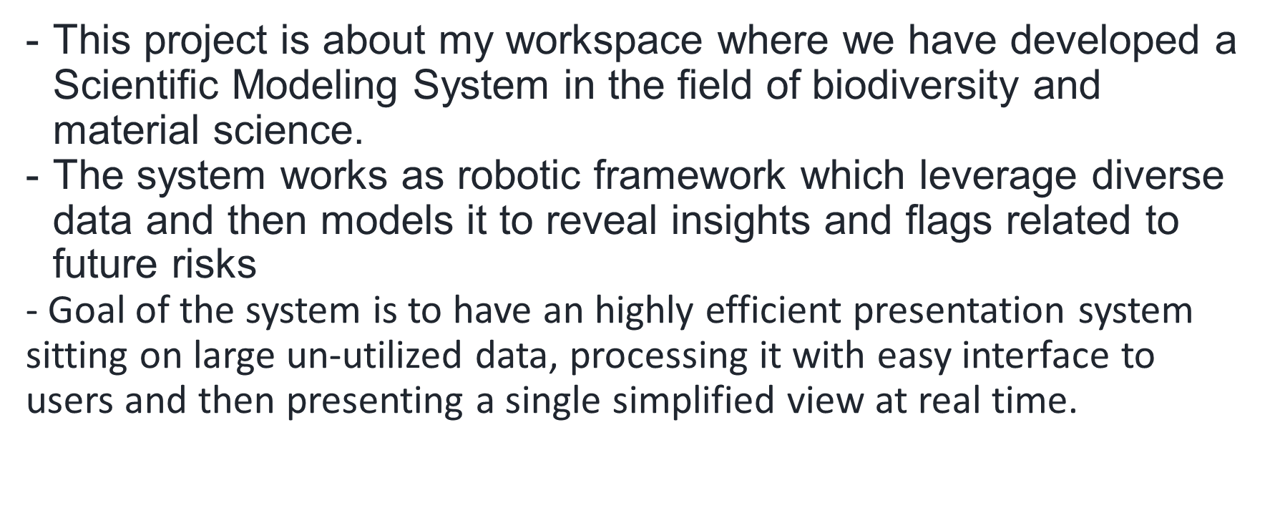
System and Goal

Slide 3


